Slide 1



Illinois Maternal Health Task Force
Speaker Series: Overview of Birth Centers
April 2nd, 2024
Please be advised that this Zoom meeting is being recorded.
All attendees are muted upon entry.
Please use the chat function for questions and technical assistance needs.
You can also email Lauren at lsayah2@uic.edu
1

Slide 2
Please observe a moment of silence for the individuals and families who have been impacted by maternal morbidity and mortality and for all who are
affected by institutional, systemic, and interpersonal racism.

Slide 3



Introducing Our Guest Speakers:
Gayle Riedmann, CNM-FPA, MS, FACNM
Co-Chair
Illinois Birth Center Task Force of Health and Medicine Policy Research Group
Jeanine Valrie Logan
Founder and Lead Steward
Chicago South Side Birth Center
Laura Wiegand
COO/Co-Founder
Birth Partners, INC.
9

Slide 4


MOVING FORWARD:
Making Progress for Birth Centers
In Illinois

Slide 5
BIRTH CENTER: AABC Definition
The birth center is a health care facility for childbirth where care is provided in the midwifery and wellness model. The birth center is freestanding and not part of a hospital.
Birth centers are an integrated part of the healthcare system and are guided by principles of prevention, sensitivity, safety. appropriate medical intervention and cost-effectiveness. While the practice of midwifery and the support of physiologic birth and newborn transition may occur in other settings, this is the exclusive model of care in a birth center.
The birth center is described with 5 Ps:
People Place Program Practice of Midwifery Part of the System
-American Association of Birth Centers “What is a Birth Center”

Slide 6
BIRTH CENTER: ILLINOIS Definition
“Birth Center” means a designated site, other than a hospital:
in which births are planned to occur following a normal, uncomplicated, and low-risk pregnancy;
that is not the pregnant person’s usual place of residence;
that is exclusively dedicated to serving the childbirth-related needs of pregnant persons and their newborns, and has no more than 10 beds;
that offers prenatal care and community education services and coordinates these services with other health care services available in the community; and
that does not provide general anesthesia or surgery
-Birth Center Licensing Act: Illinois Public Act 102-0518

Slide 7

BIRTH CENTERS

Slide 8
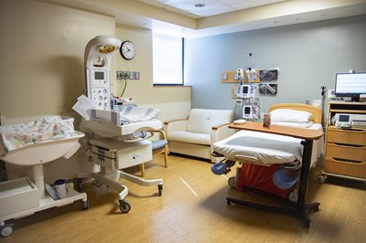
HOSPITAL BIRTH CENTERS

Slide 9
BIRTH CENTERS: FACTS
There are more than 400 Birth Centers operating in 40 states and D. C., including surrounding states Michigan, Indiana, Missouri, Iowa, and Wisconsin
The number of midwifery-led birth centers has doubled in the last decade
Birth centers are located in inner city urban areas, rural, and suburban sites
FOR MORE INFO...
American Association of Childbearing Centers (AABC)
www.birthcenters.org

Slide 10
BIRTH CENTERS: SAFETY
Lower C-section rate
Higher vaginal birth after cesarean (VBAC) rate
Fewer low birth weight newborns
Lower preterm birth rate
Higher rate of exclusive breastfeeding
Reduction in racial/ethnic disparities for maternal and infant outcomes
FOR MORE INFO...
Strong Start for Mothers and Newborns Initiative National Report
Jan 8, 2019 Diane W Shannon MD, MPH

Slide 11

BIRTH CENTERS
The
Illinois
Experience
FOR MORE INFO...
Health and Medicine Policy Research Group
www.hmprg.org

Slide 12
ILLINOIS BIRTH CENTER TASK FORCE
Formed in 1987
Part of Health and Medicine Policy Research Group (HMPRG): an independent policy center that conducts research, educates, and collaborates with other groups to advocate policies and impact health systems to improve the health status of all people.
Identified the need for birth centers in Illinois to provide choices and improve access to maternity services and providers
Partnered with I PROMOTE IL in 2020
FOR MORE INFO...
Health and Medicine Policy Research Group hmprg.org
I PROMOTE IL ipromoteil.org

Slide 13
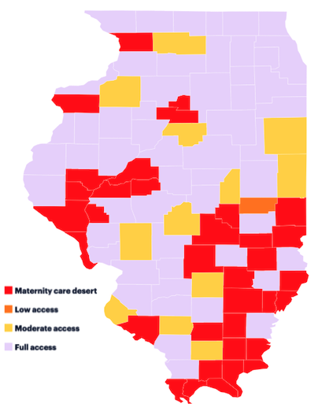
BIRTH CENTERS IN ILLINOIS Why Bother?
Access to Maternity Care
Safety
Reduced Cost
Midwifery Model of Care
    Culturally sensitive
    Family-Centered
    Home-like setting
    Physiologic birth

Slide 14
THE ILLINOIS EXPERIENCE
Coming together is a beginning,
Keeping together is progress,
Working together is success.
-Henry Ford
The Illinois Birth Center Task Force introduced
9 legislative bills from 1989 to 2007.

Slide 15
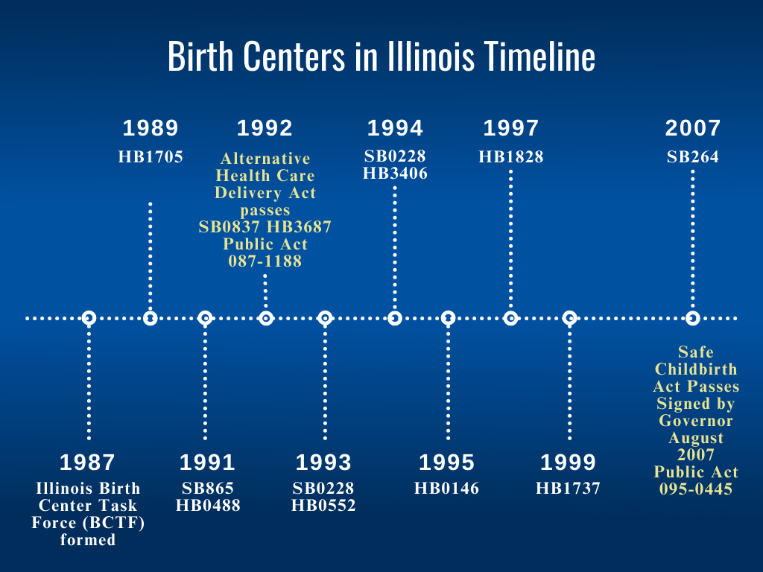
IllINOIS BIRTH CENTER TASK FORCE
TIMELINE
FOR MORE INFO...
hmprg.org

Slide 16
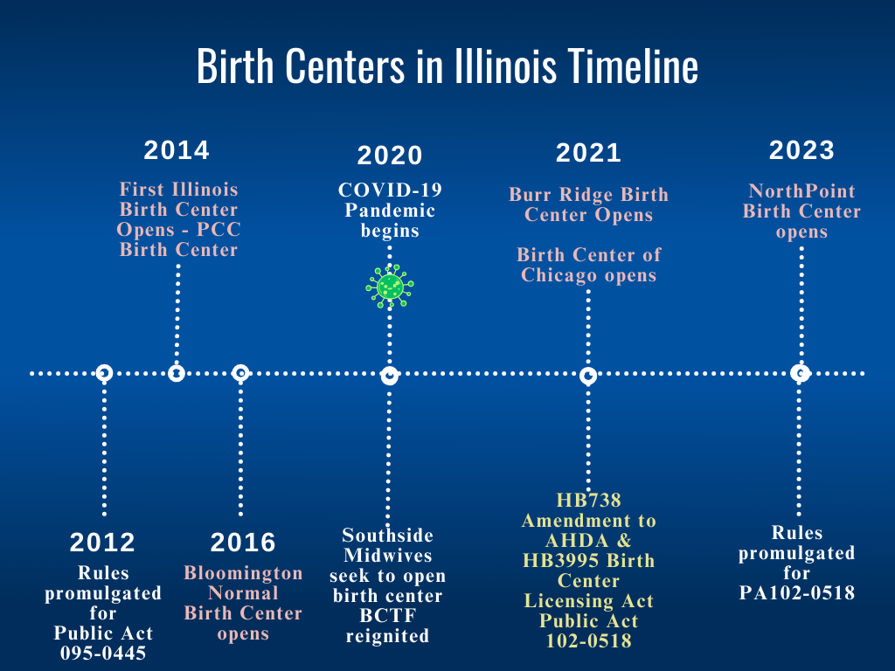
IllINOIS BIRTH CENTER TASK FORCE
TIMELINE
FOR MORE INFO...
hmprg.org

Slide 17
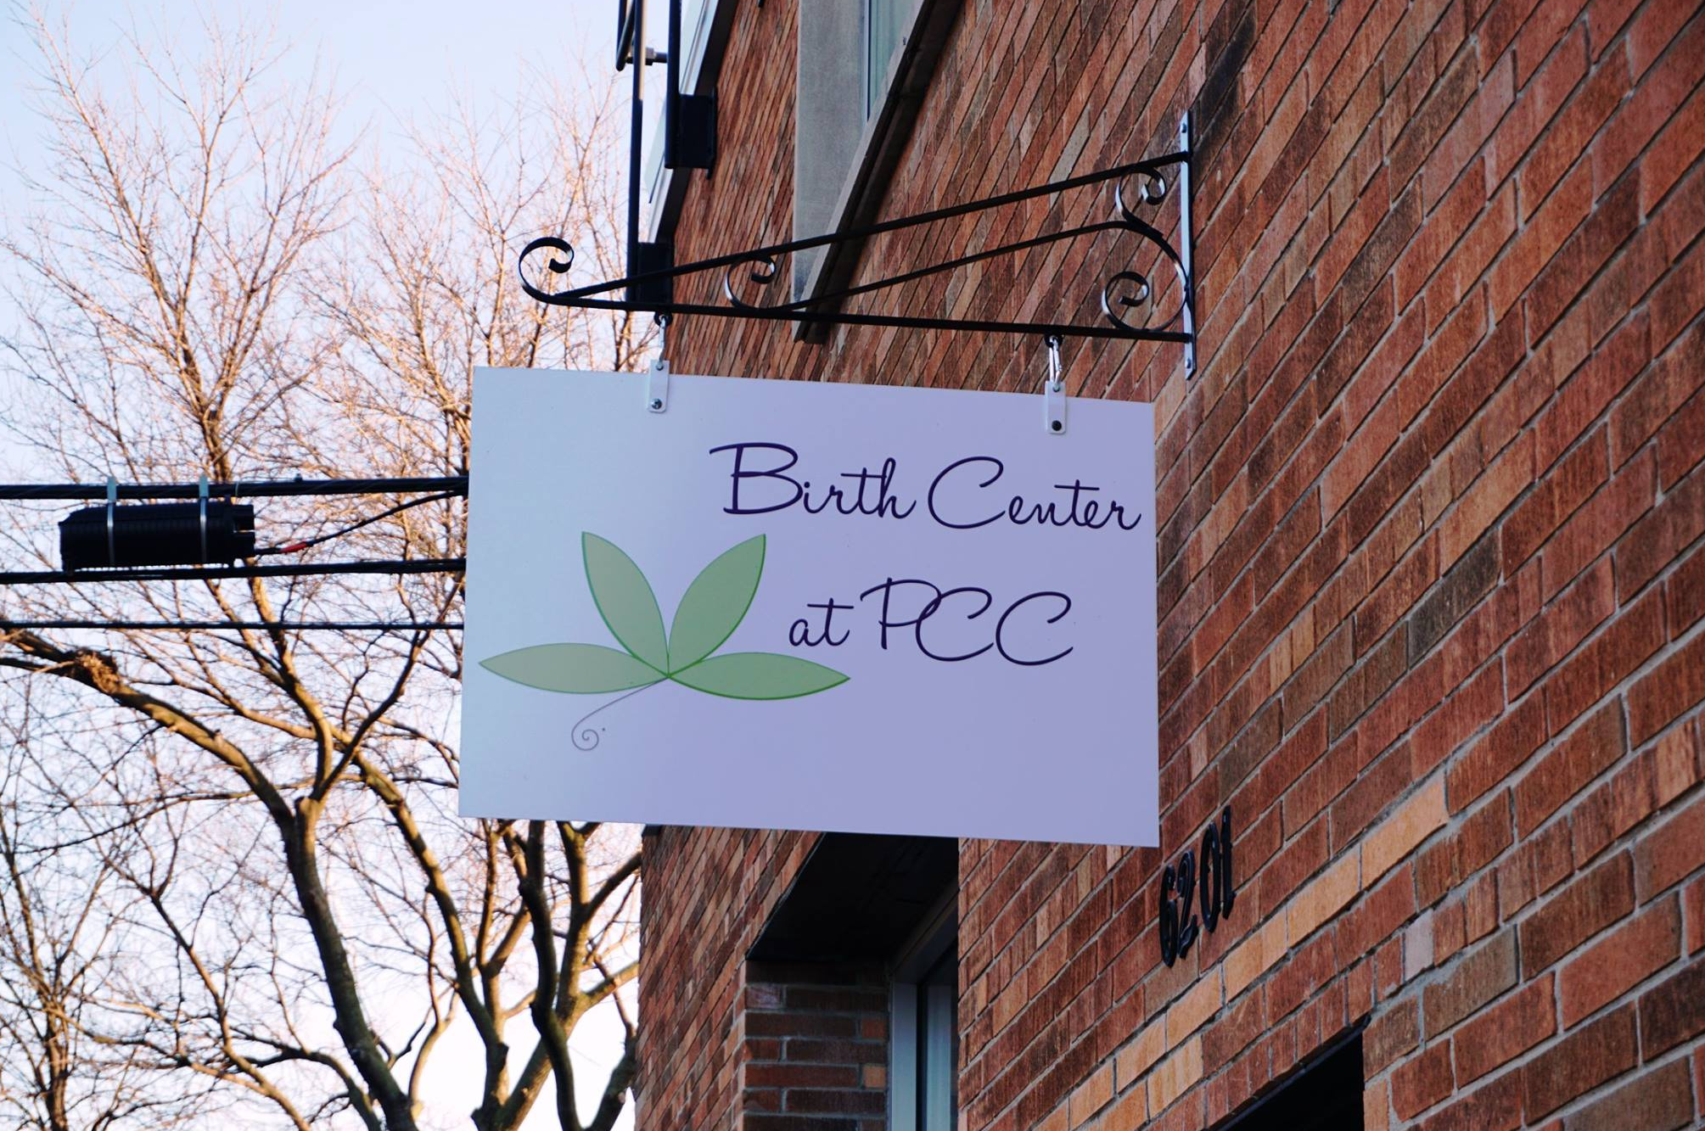

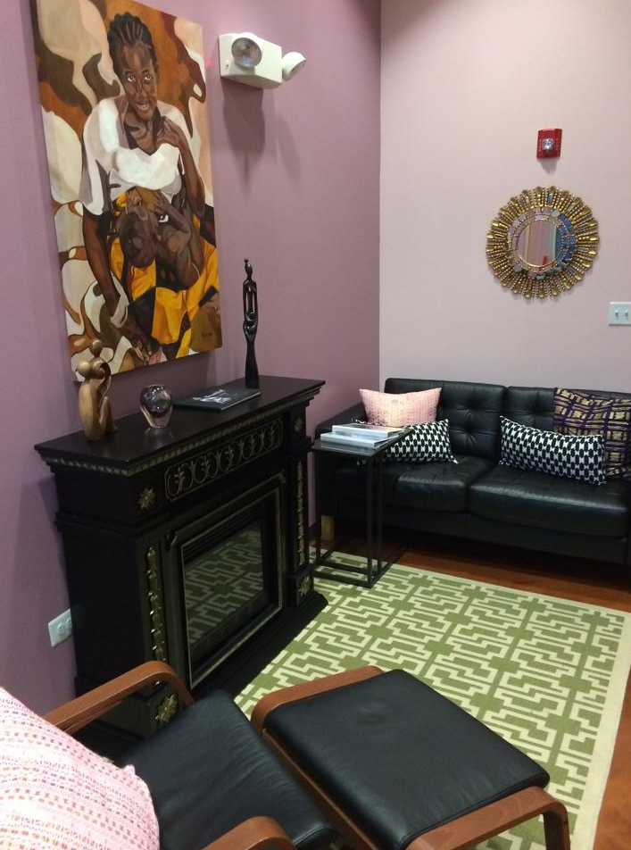
ILLINOIS’ FIRST BIRTH CENTER

Slide 18
TIMELINE
1987 Illinois Birth Center Task Force (BCTF) formed
1988 1st Birth Center Conference
1989 Demonstration in front of State of IL Building
Legislative Bills introduced 1989, 1991, 1992,1993,1994, 1995, 1997, 1999, 2007
1992 Alternative Health Care Delivery Act Passed
2007 Amendment to Alternative Health Care Delivery Act, Safe Childbirth Act: Birth Centers passed and signed into law as PA 095-0445
2008 Birth Center conference: Moving Forward: Delivering Birth Centers in Illinois in collaboration with AABC How to Build a Birth Center Workshop
2012 Rules Promulgated
2014 1st Illinois Birth Center Opens: PCC Birth Center
2016 Bloomington Normal Birth Center Opens
2020 COVID Southside Midwives seek to open Birth Center- BCTF reingited
2021 Legislation introduced and passed, An Amendment to Alternative Health Care Delivery HB738 Act AND Birth Center Licensing Act HB 3995 PA 102-0518
2021 Burr Ridge Birth Center Opens
2021 Birth Center of Chicago Opens
2022 Rules Promulgated PA 102-0518
2023 NorthPoint Birth Center Opens

Slide 19
THE ILLINOIS EXPERIENCE: BARRIERS
Only 2 Birth Centers opened between 2012 and 2020
The operation of these birth centers shed light on barriers to the opening and sustainable operation of Birth Centers in Illinois. The Birth Center pilot program of the AHDA demonstrated safety, but restrictions were limiting development of new birth centers.
A confluence of sociocultural, political, and economic events and influences in 2020 led to the introduction of 2 legislative bills: An amendment to the AHDA, and a separate bill for full Birth Center Licensing.

Slide 20
IllINOIS BIRTH CENTER TASK FORCE
TIMELINE
FOR MORE INFO...
hmprg.org

Slide 21
EXISTING BIRTH CENTERS IN ILLINOIS
Birth Center at PCC (2014) Berwyn, IL
Birth Center of Bloomington Normal (2016)
Burr Ridge Birth Center (2021)
Birth Center of Chicago (2021)
NorthPointe Birth Center (2023) Roscoe, IL

Slide 22
DEVELOPING BIRTH CENTERS IN ILLINOIS
Chicago Southside Birth Center
QMG Birth Center, Quincy IL
Illinois Valley Birth Center , Peru, IL
Spero Family Services, Mount Vernon, IL
Notes:
Illinois Valley Birth Center (Ottawa, IL)
Chicago Southside Birth Center

Slide 23
THE ILLINOIS EXPERIENCE
The secret of change is to focus all of your energy, not on fighting the old, but on building the new.
-Socrates
(The gas station attendant, not the Greek philosopher)

Slide 24
THE ILLINOIS EXPERIENCE: BARRIERS
In 2024, the 5 Existing and 4 Developing Birth Centers in Illinois have ongoing challenges:
Transfer Agreement required with nearby hospitals, and some of those hospitals are in another state
Certificate of Need requirement restricts access of maternity services through stringent and costly regulations, and do not improve safety or birth center quality of care.
Legislative Rules may restrict access to vaginal birth after cesarean (VBAC) in Birth Centers
Reimbursement for birth and newborn services is sometimes reduced, restricted or denied

Slide 25
THE ILLINOIS EXPERIENCE: BARRIERS
Never give in! Never give in!
Never, never, never, never--
in nothing, great or small, large or petty--
never give in, except to convictions
of honor and good sense.
-Winston Churchill

Slide 26

THE ILLINOIS EXPERIENCE

Slide 27

Chicago South Side Birth Center
An Community Centered Option for Improving Access and Outcomes on Chicago’s South Side
Jeanine Valrie Logan, MPH, MSN, CNM Founder and Lead Steward

Slide 28

The Need & The South Side

Slide 29


Current OB Ecosystem on the South Side:
Geographical Desert Lack of Continuity
Client Distrust and Dissatisfaction Systemic Racism
Racialized Obstetric Trauma OB Closures

Slide 30

Infant Mortality in the 10th ward
Community areas
Per 1,000 live births %ile Rank
South Shore | 14.0 | 95th | 5th
Hegewisch | 6.0 | 51st | 39th
East Side | 2.7 | 14th | 67th
South Deering | 12.9 | 92nd | 7th
Altgeld Gardens | 13
Riverdale | 10.1 | 83rd | 14th
South Chicago | 15.8 | 99th | 2nd
Chicago (2005-2009) | 8.1
(https://chicagohealthatlas.org/indicators/VRIMR?topic=infant-mortality-rate) (https://data.cityofchicago.org/Health-Human-Services/Chicago-Infant-Mortality/5qqb-uvkn)
(https://www.uchicagomedicine.org/-/media/pdfs/adult-pdfs/community/chna-community-profiles/riverdale-community-profile.pdf)

Slide 31

What is a Birth Center?
A “wellness model” guided by principles of prevention, sensitivity, safety, appropriate medical intervention, and cost effectiveness
Free standing, home-like atmosphere that is centered within the healthcare system
Birth centers provide family- centered care before, during and after normal pregnancy, labor, and birth

Slide 32
Midwife-led Birth Center Model of Care
Research
(NBCS II, 2013)
Model of Care
“Wellness” model of care
Midwife led
Low and mixed risk Longer visits Continuous care in labor Education focused Follow up care in the home
Community engaged
Illinois
Lower c-section rate (6%)
Lower transfers for ER (16%)
Similar rates across birth settings for stillbirth and newborn deaths for low risk pregnancies
Transfer agreement Perinatal Center Collaborating DO or MD Meet national standards of American Association of Birth Centers (AABC) Accredited with Commission for the Accreditation of Birth Centers (CABC)

Slide 33
About Chicago South Side Birth Center

Slide 34

Our Mission
To provide concordant, culturally safe, evidence based midwifery care alongside families and within community to improve outcomes, promote wellness, and abundance in whole health.

Slide 35
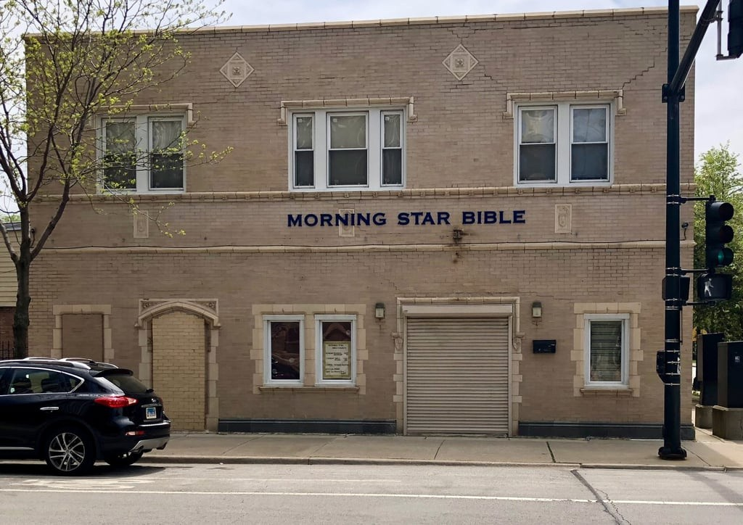

Our Future Home
www.resilia.com

Slide 36



Envisionist Future Ecosystem on the South Side:
Midwife led
Improve health/be an interrupter to poor outcomes
Centering the experiences of clients and their culture
Concordant care Community engagement
Multiple “Perinatal Safe Zones”

Slide 37
Thank you!
Contact: Jeanine Valrie Logan
Chicago South Side Birth Center Initiative
chicagosouthsidebirthcenter@gmail.com www.chicagosouthsidebirthcenter.org

Slide 38

BIRTH CENTERS
THE VIABLE SOLUTION
P R E P A R E D B Y
L A U R A W I E G A N D , C O O & C O F O U N D E R B I R T H P A R T N E R S , I N C

Slide 39
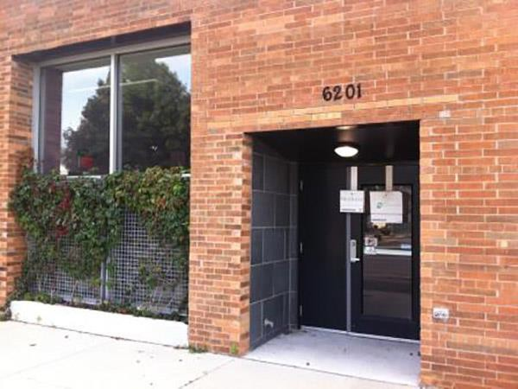
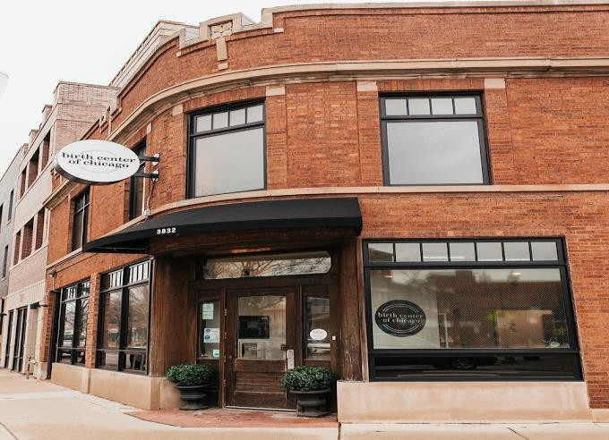
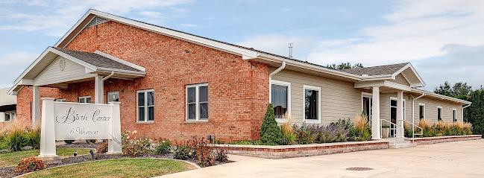


B I R T H
C E N T E R S O F I L L I N O I S
Birth Center at PCC
Birth Center of Bloomington-Normal Burr Ridge Birth Center
Birth Center of Chicago NorthPointe Birth Center
Birth Center at PCC
Birth Center of Chicago
Started January 2020
Licensed November 2021
  22 months
Birth Center of Bloomington-Normal
Started November 2013
Licensed September 2016
  34 months
Burr Ridge Birth Center
Started November 2018
  Licensed April 2021
    29 months
NorthPointe Birth Center

Slide 40








S O M E
O F T H E C H A L L E N G E S
E N T D E V E L O P I N G
C U R R

Slide 41

The Problems
Maternal & Birth Outcomes are not improving in the US
Obstetric costs in the US continuing to increase
US outcomes are worse than some 3rd world countries
Birth Centers can help provide a solution;
However, are not sustainable with current reimbursements rates

Slide 42
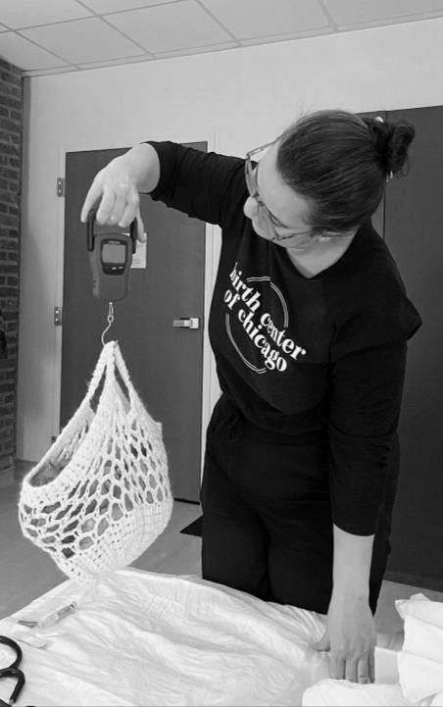
OUTCOMES
2020 | US Birth Centers | US Hospitals
Maternal Mortality | 0.7/100,000 | 21/100,000 th (64 in the world)*
Cesarean rate | <6% | 33%
Epidural rate | 10% | 65-80%
NICU admit | 2.5% | 5.6%
Midwife-attended births | >99% | <8%
Birth Centers are also seeing outstanding outcomes with: decrease infections rates, episiotomy rates, breastfeeding & lactation, low birth weight, preterm birth, ER / ED visits, patient satisfaction rates, and TOLAC / VBAC successes.
*3/18/2024: the most recent data was released in the American Journal of Preventive Medicine and
the MMR is now 31.8 (2020 rate: 21)

Slide 43
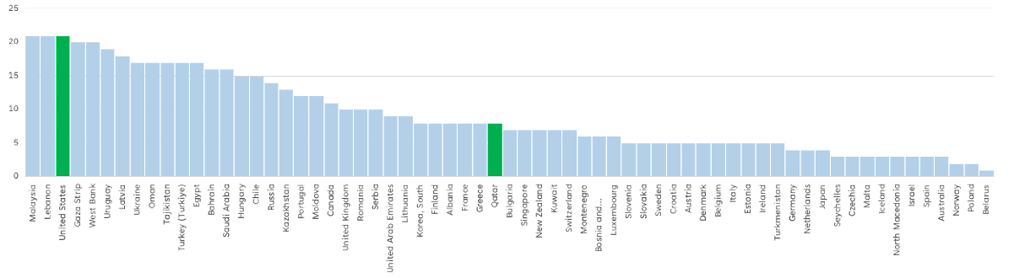
Our Global Standing
34th
64th
The US is 64th , this was our global standing in 2020; based on 21 maternal deaths per 100,000.
The country of Qatar (34th), indicates where 34 developed nations are in the list
  There are 64 developed nations according to OECD (Organization for Economic Co-operation and Development)

Slide 44
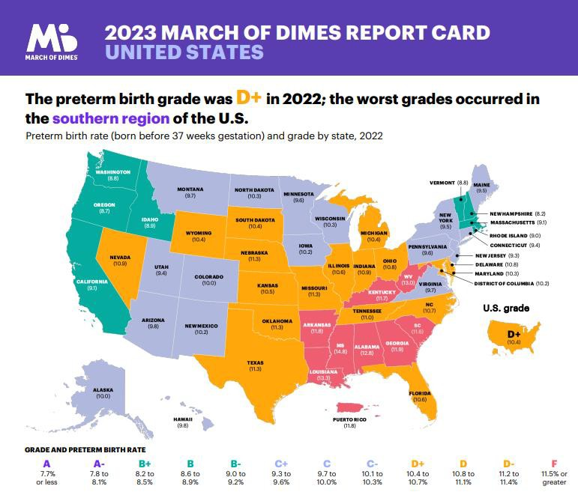
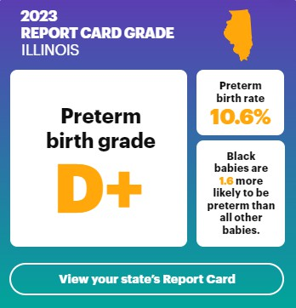
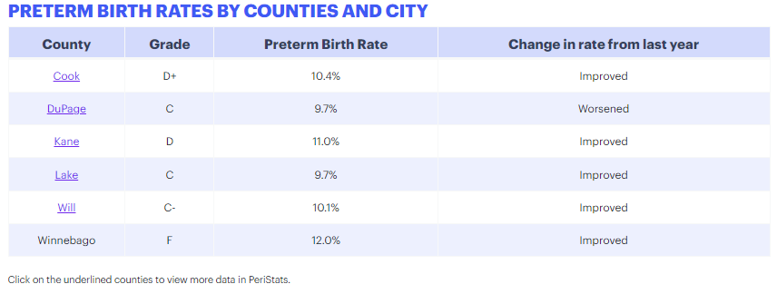
MOD Report Card

Slide 45
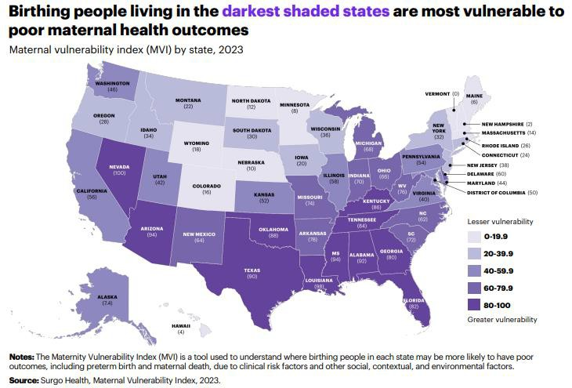
MOD Report Card

Slide 46
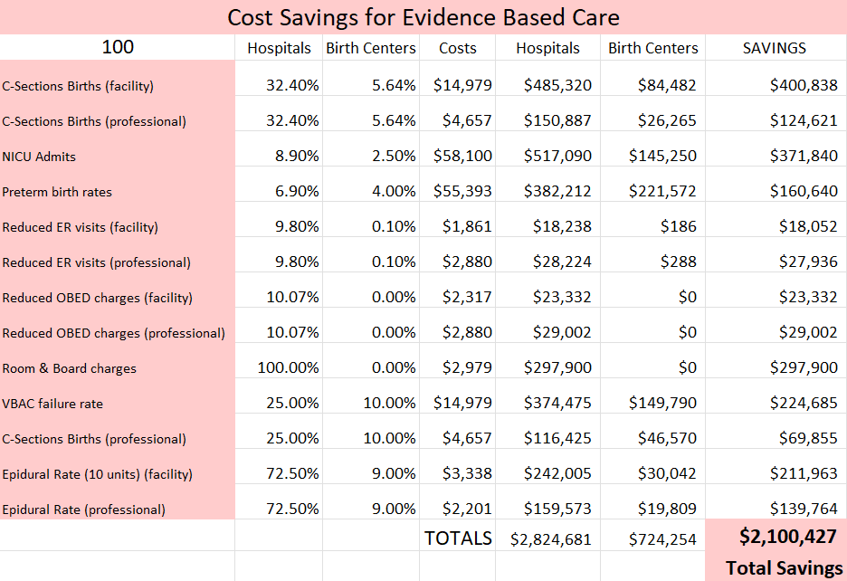
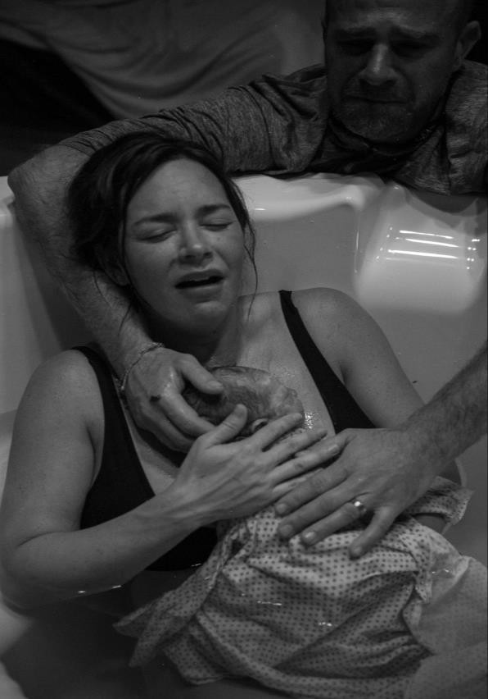
Examples of Cost Variances
(source: Turquoise Health)

Slide 47


MS-DRG Medicare Severity Diagnosis Related Groups
783 - Ceserean with Sterilization - MCC
784 - Ceserean with Sterilization - CC
785 - Ceserean with Sterilization - no CC/MCC
805 - Ceserean - MCC
806 - Ceserean - CC
807 - Ceserean -no CC/MCC
768 - Vaginal Birth with OR
786 - Vaginal Birth - MCC
787 - Vaginal Birth - CC
788 - Vaginal Birth - no CC/MCC
796 - Vaginal Birth with Sterilization - MCC
797 - Vaginal Birth with Sterilization - CC
798 - Vaginal Birth with Sterilization- no CC/MCC
(source: Turquoise Health)

Slide 48
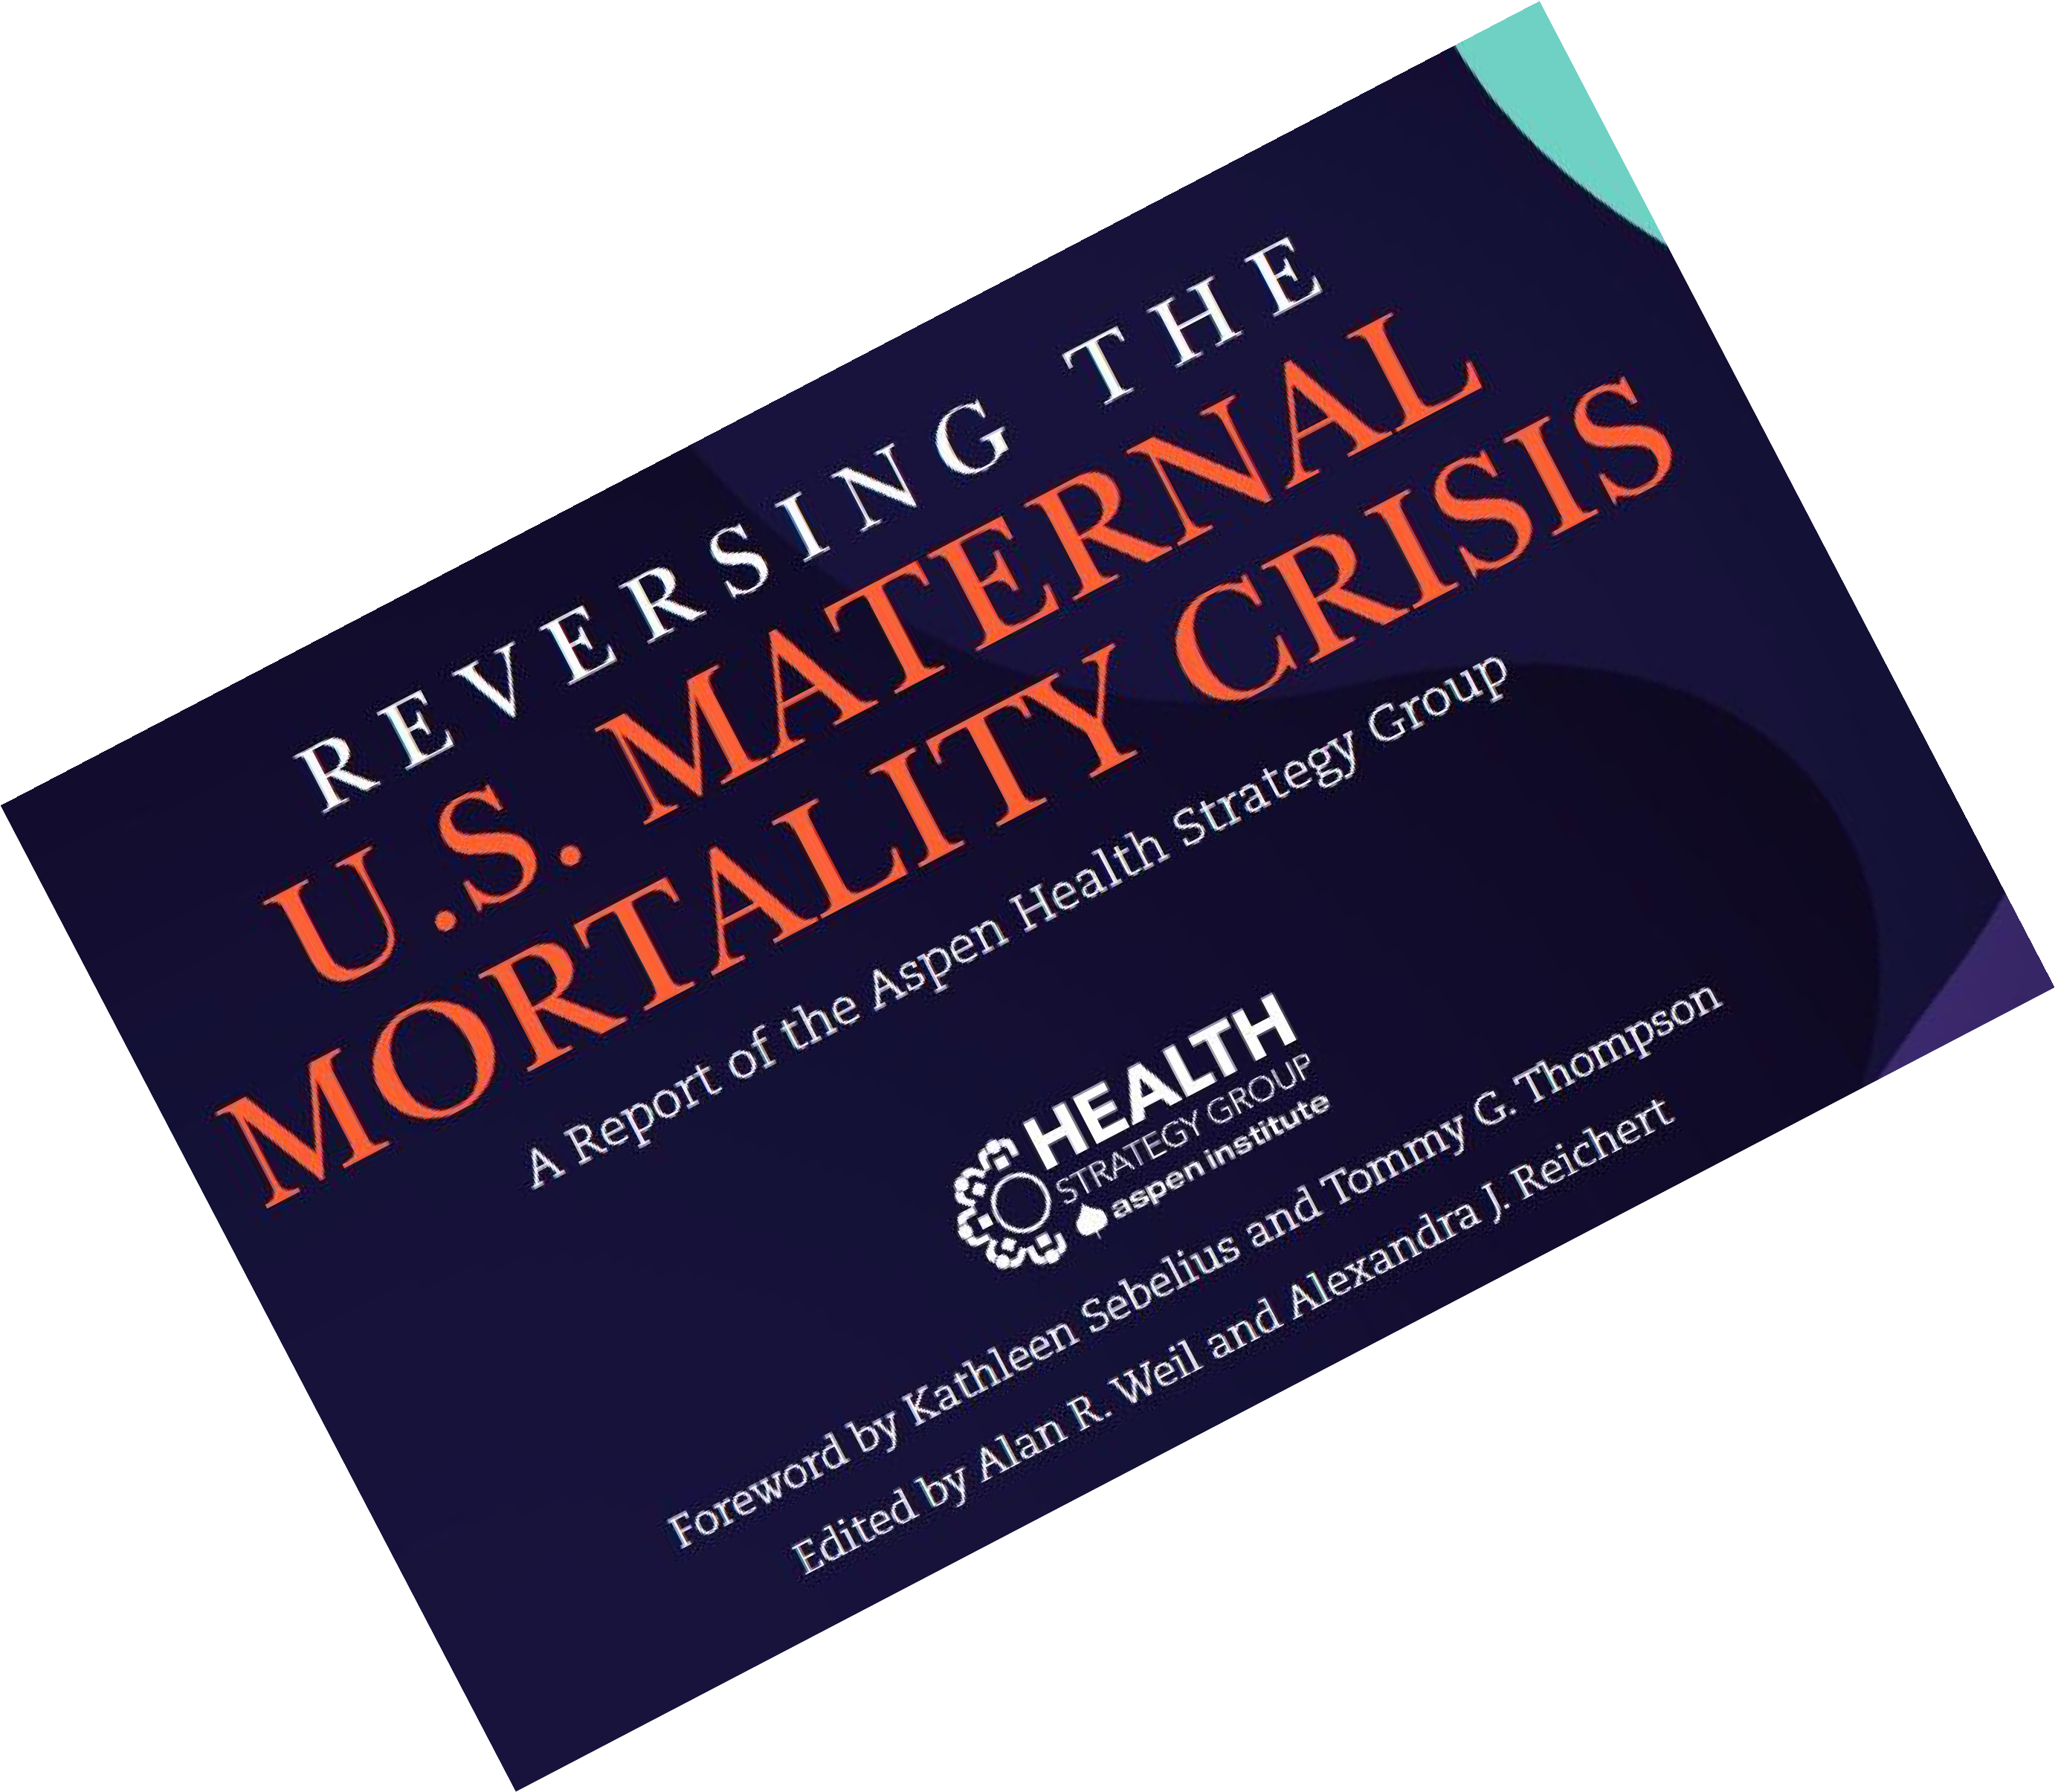
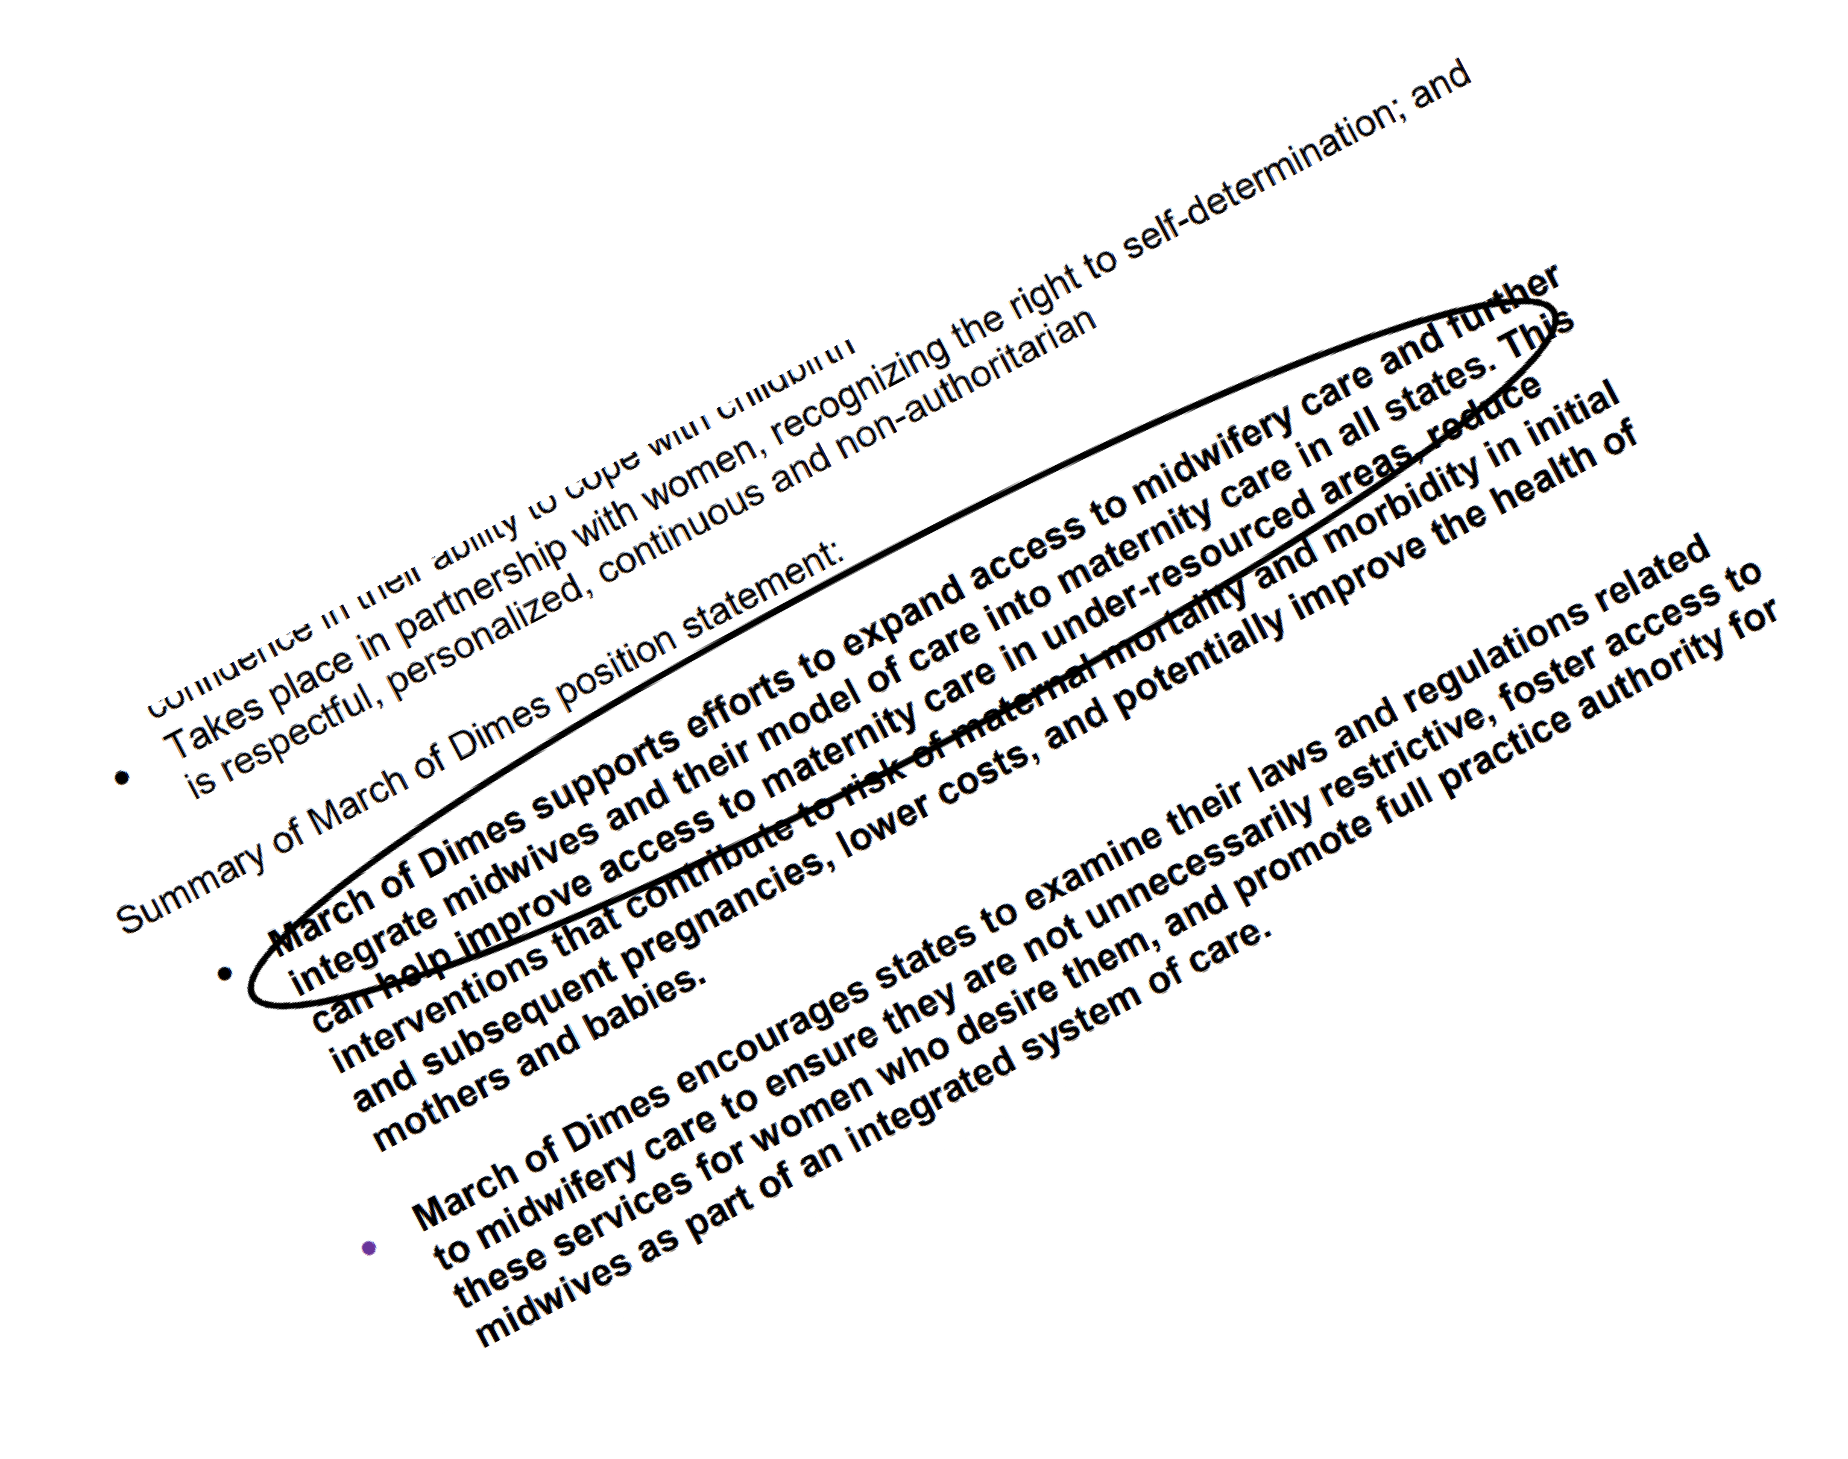

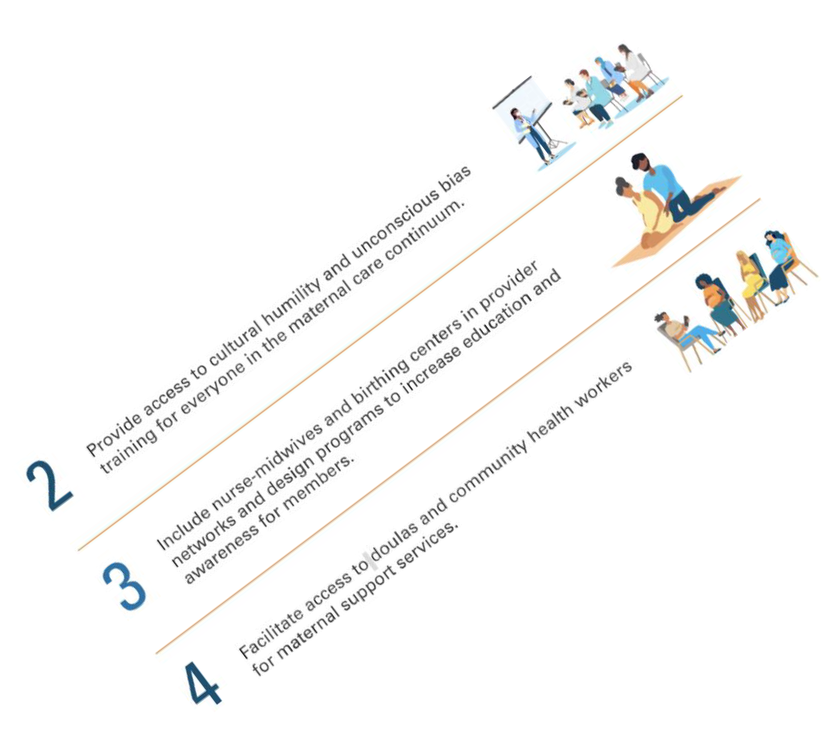
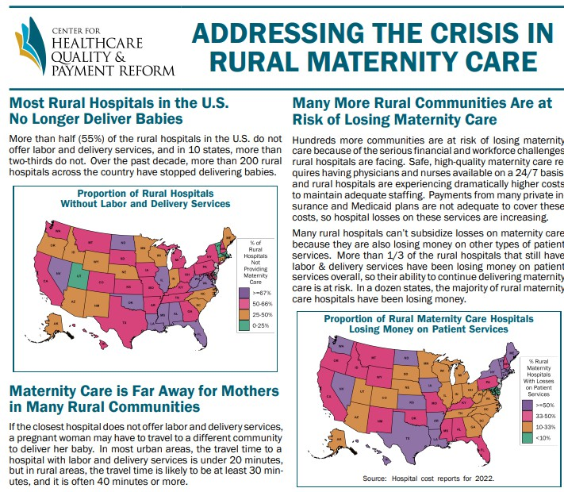

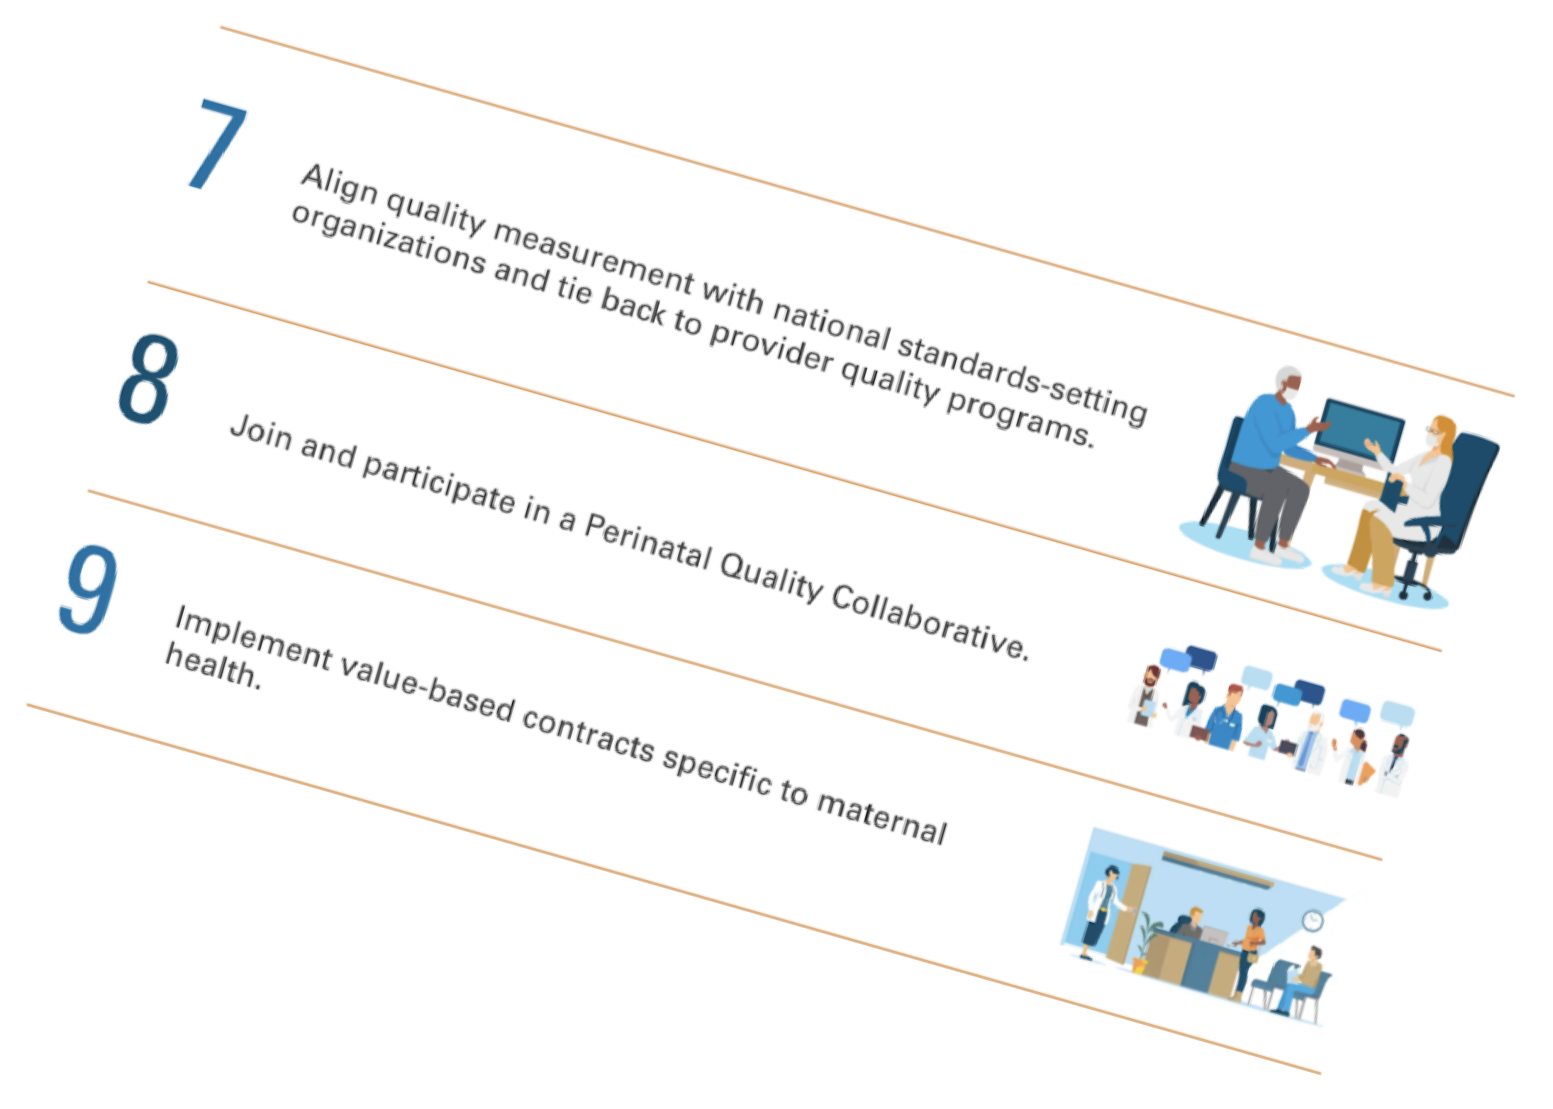
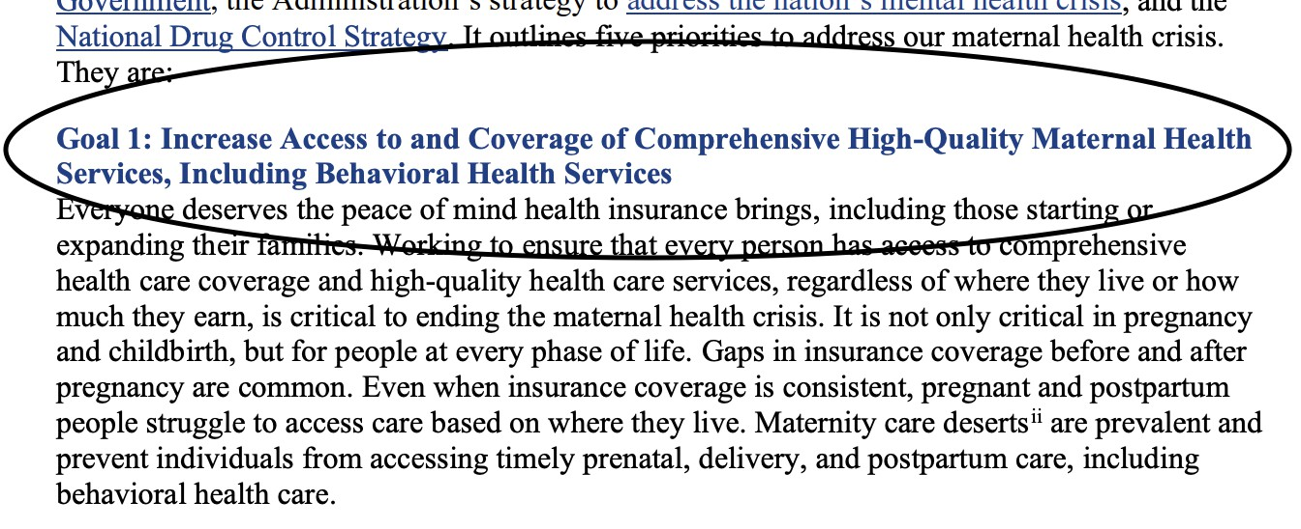
Supporters
AABC
ACOG
AWHONN
Aspen Health
Black Mamas Matter Alliance
Blue Cross Blue Shield Association
Blue Distinction
CABC
CDC
Centers for Healthcare Quality & Payment Reform
Century Foundation
CMS – Transforming Maternal Health (TMaH)
Commonwealth Fund
Every Mother Counts
Families USA
Foundation for Healthcare Quality
Health Care Cost Institute
HRSA
March of Dimes
March for Moms
Maternal Health Task Force
Maternal Mortality Review Committees
Medicaid Programs
Midwife Associations: ACNM, NACPM, NARM
National Academy for State Health Policy
National Institute of Child Health & Human Development
National Institute of Health
National Partnership for Women & Families
Regence (Value-based Payments for Episodes of Care)
Surgeon General
Strong Start
United Nations Populations Fund
WHO

Slide 49
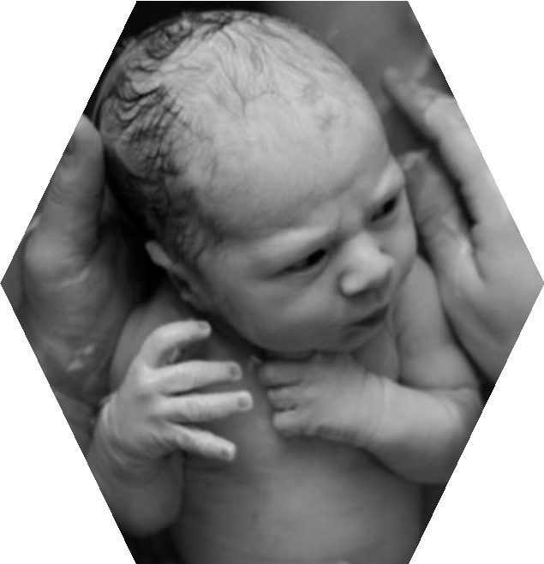
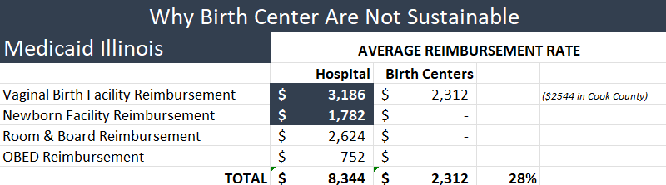
Illinois Medicaid Reimbursements
Medicaid Payment Method:
42 % Hospitals
19 % Birth
Centers
(Source: MOD)
Other State Medicaid’s (traditional, MCO, & CCO) reimbursing Birth Centers at the same rates as hospitals:
New York
New Jersey
Oregon
North Carolina
Ohio
Washington (in-process)
Texas (proposed)
(source: IDHFS & Turquoise Health)

Slide 50

America Association of Birth Centers Efforts
Teaching Equitability & Sustainability
Teaching Contract Negotiations and Contracting
Presenting to
  Medicaid
  Tricare
  Insurances
  Health Savings Plans
  Federal & State Representatives
Developing Sustainability Position Statement(s)
Changing the Industry Standard &
Setting the Industry Standard

Slide 51
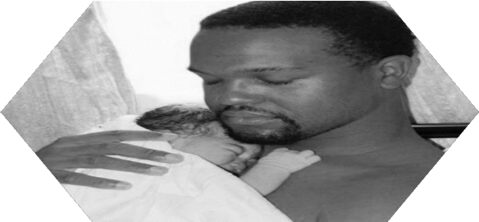
How to support Birth Centers
Full implementation of section 2706 of the ACA which details inclusion and reimbursement without discrimination of all licensed birth attendant types, including MD, DO, ND, DC, CNM, LM, CPM, by every insurance plan, public or private, that receives federal dollars in any form.
Full and sustainable implementation of section 2301 of the ACA which calls for the inclusion and reimbursement of freestanding birth centers.
Separate reimbursement for each patient cared for including the parent and the baby for both professional and facility.
Standardized billing codes recognition, regardless of location (hospital or birth center)
National recognition of Accredited Freestanding Birth Centers as the first line of care,
and of midwives as the first line of care for pregnancy.

Slide 52
Questions?

Slide 53

Thank You, Announcements and Closing Remarks

Slide 54
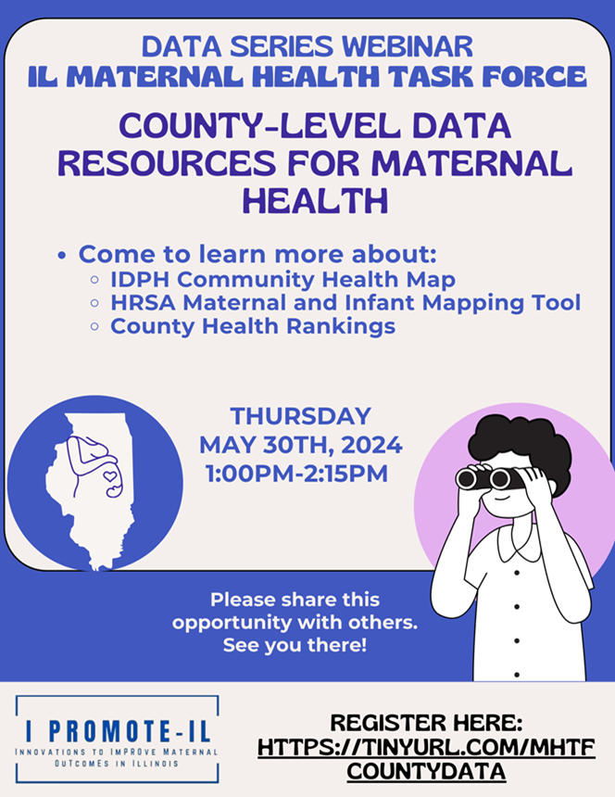

Scan to Register:

Slide 55
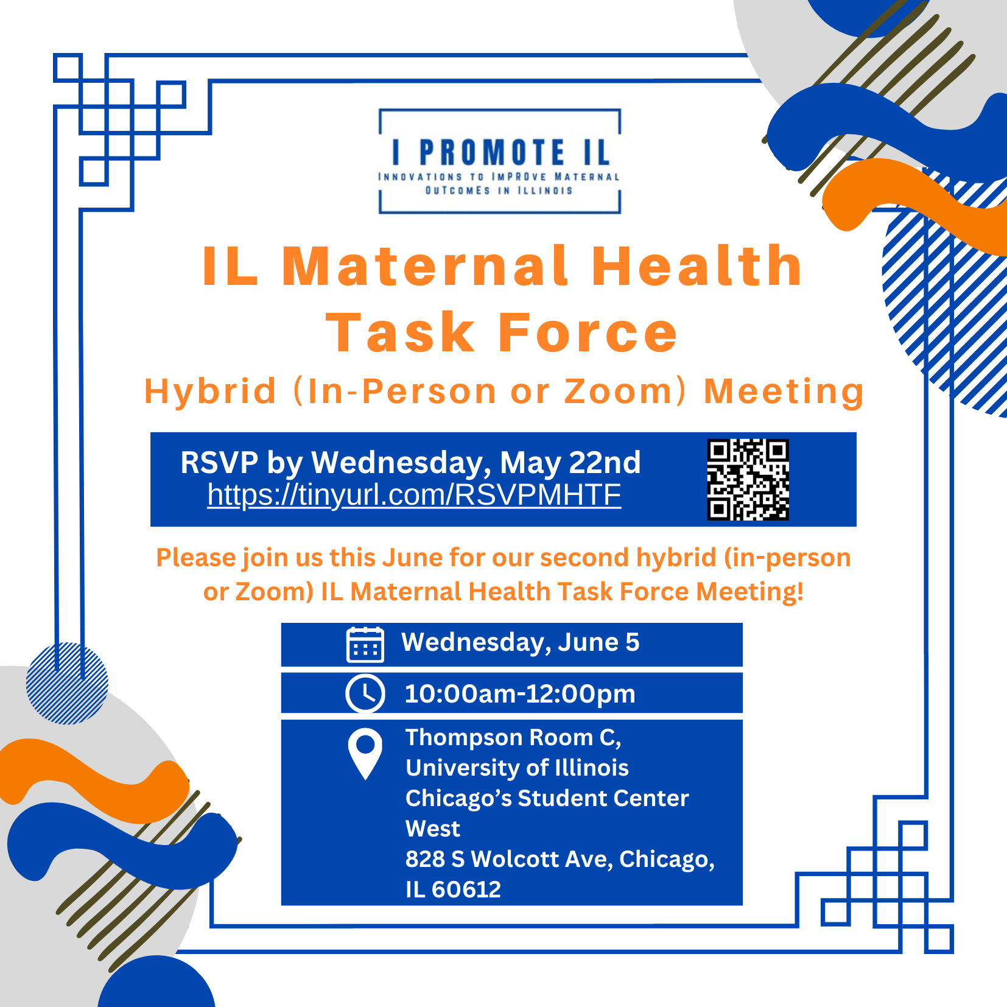

Scan to present on an initiative/
collaboration/
project:

Slide 56
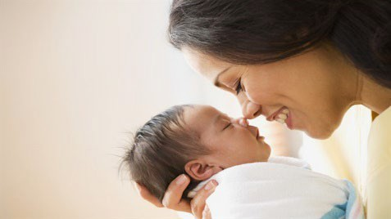
Closing
Thank you for your participation!
Any questions can be sent to Lauren Sayah (lsayah2@uic.edu)
22

